Slide 1
Visualisation Project: Investigating Data for Tornadoes in the United States from 1950-2018
Nardiena Althafia pratama

Slide 2
Problem Statement
What: Visualising data of tornado occurrences in the United States from 1950 to 2018
Why: To investigate and analyse the distribution patterns of the storms throughout the United States and how frequent and dangerous the tornadoes have been by:
Mapping the location points of each tornado occurrence on the US map
Visualising trends/patterns between casualty numbers and tornado frequencies over the years
Visualising trends/patterns between casualty numbers and tornado frequencies based on each state
Highlighting trends on casualty numbers based on the magnitude

Slide 3
Methods, Techniques, Execution and Results
Visualisations made on the Tableau software.
Dataset was retrieved from the National Oceanic and Atmospheric Administration’s National Weather Service Storm Prediction Center.
Methods and techniques:
Complex Behaviour Over Space
Complex Behaviour Over Time
Multiple Dependent Variables

Slide 4
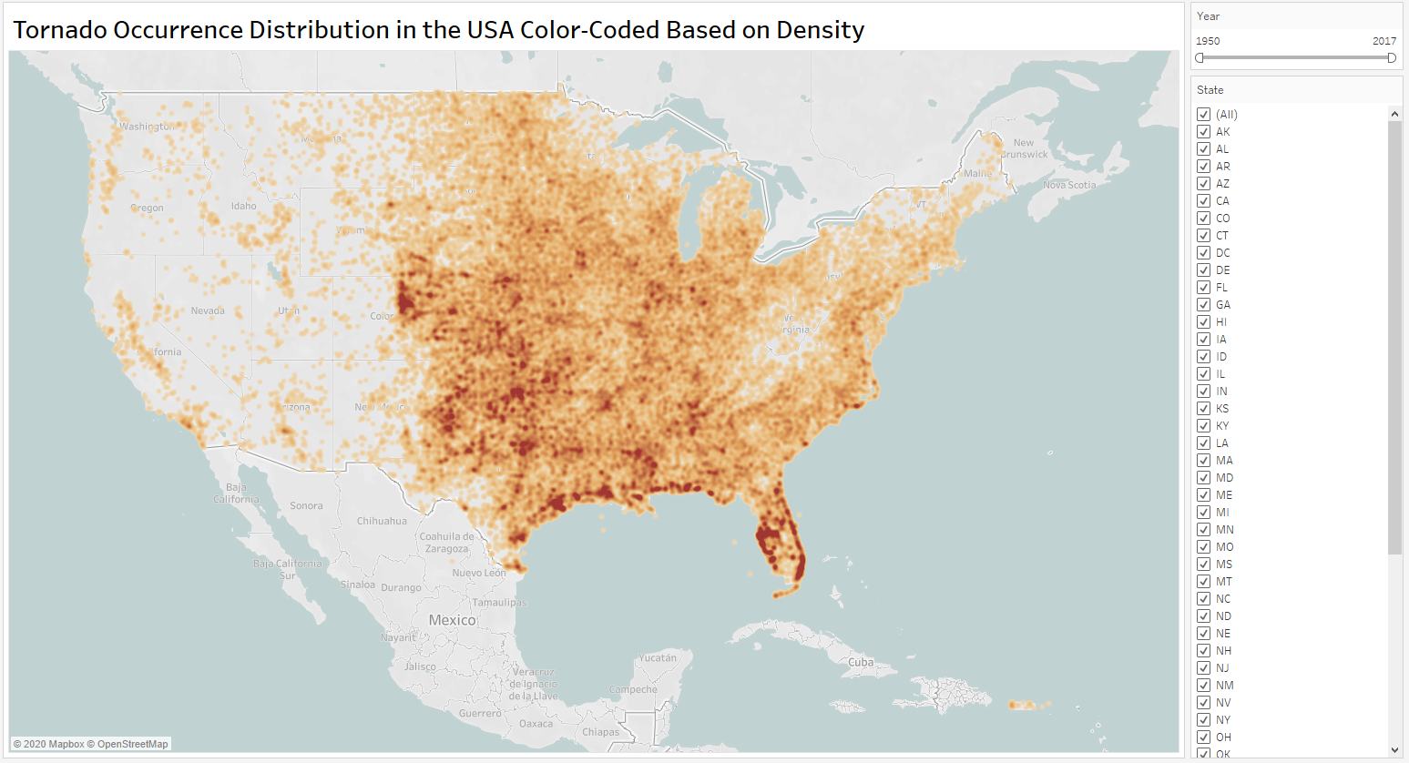
Complex Behaviour Over Space
A density distribution map showing the location points of each tornado occurrence in the United States from 1950 to 2018.
Notes:
There is a pattern of the most dense tornado areas. These include the south-eastern area, the southern borderline (Gulf Area), and areas towards the central regions of mainland US.

Slide 5
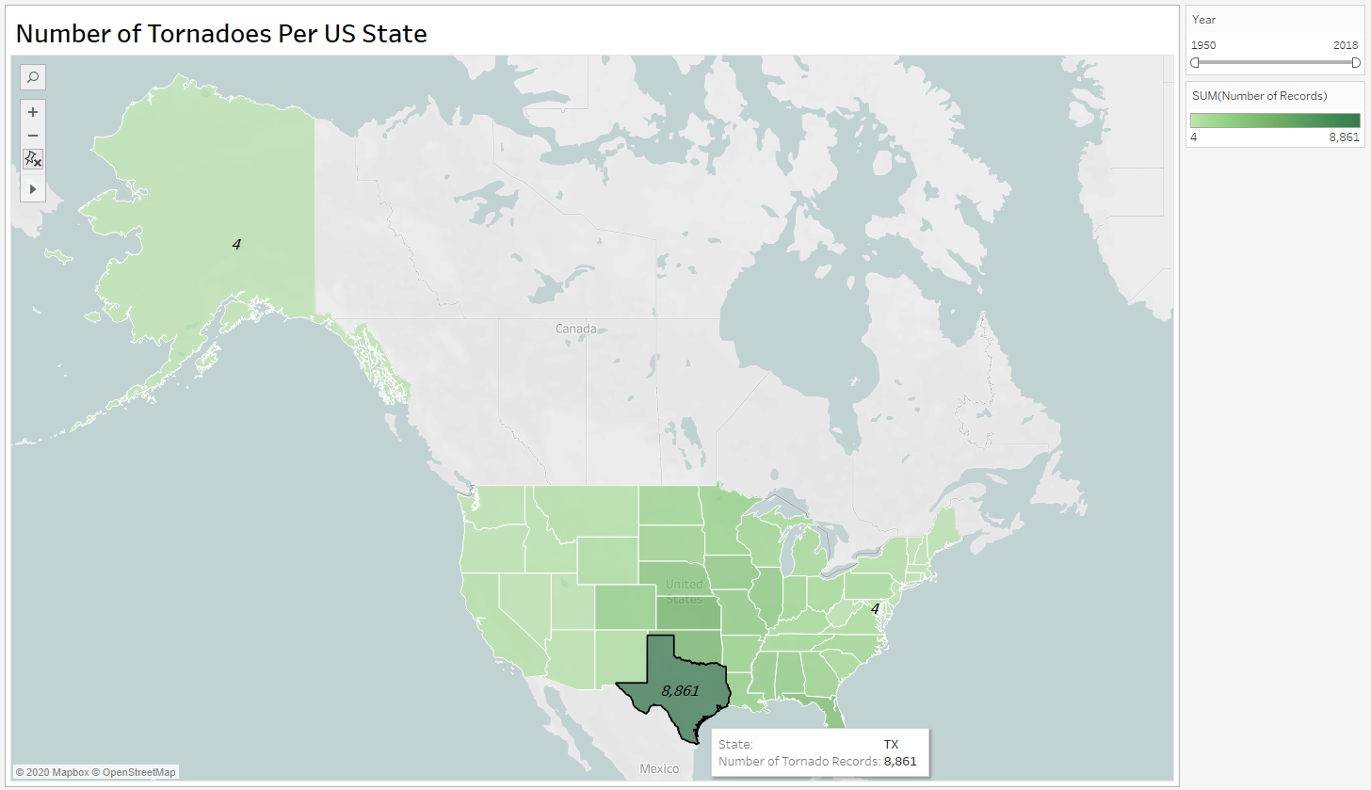
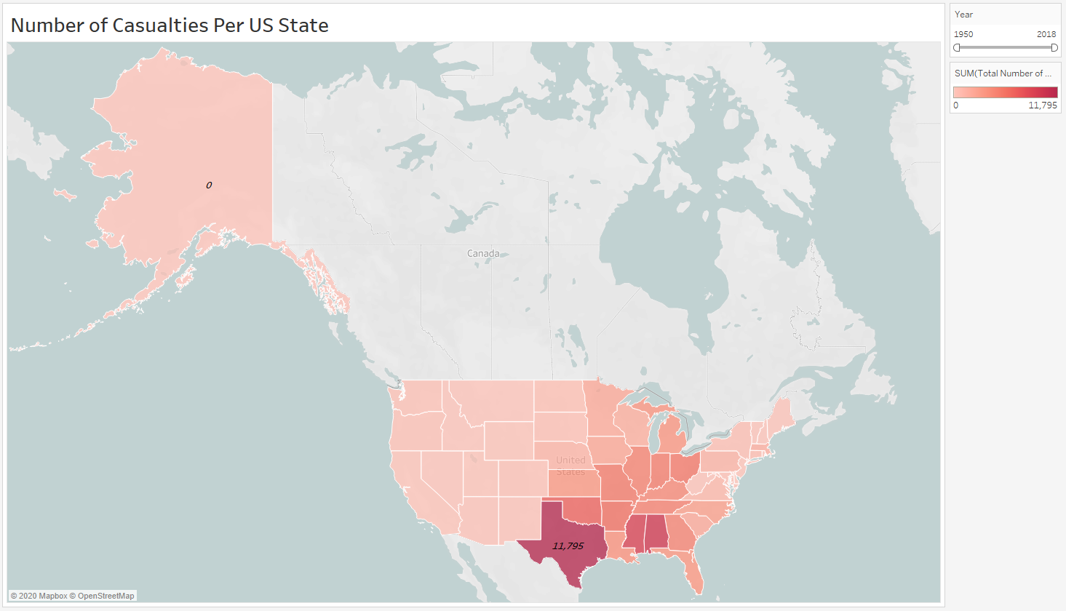
Complex Behaviour Over Space (Cont’d…)
Comparison between US state maps that show number of tornado occurrences per state and the number of casualties per state

Slide 6
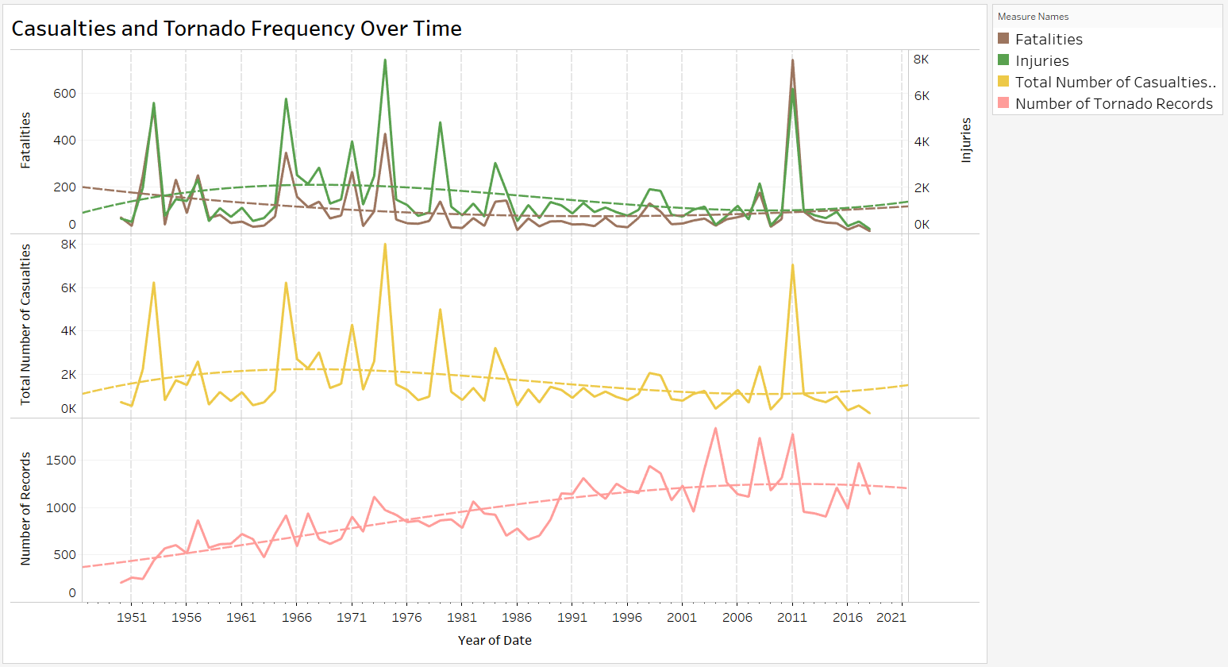
Complex Behaviour Over Time and Multiple Dependent Variables
Three stacked line graphs that show correlations between number of fatalities, injuries, total casualties, and tornado occurrences over time (years).

